Slide 1
Maintaining Plant Product Integrity

Slide 2
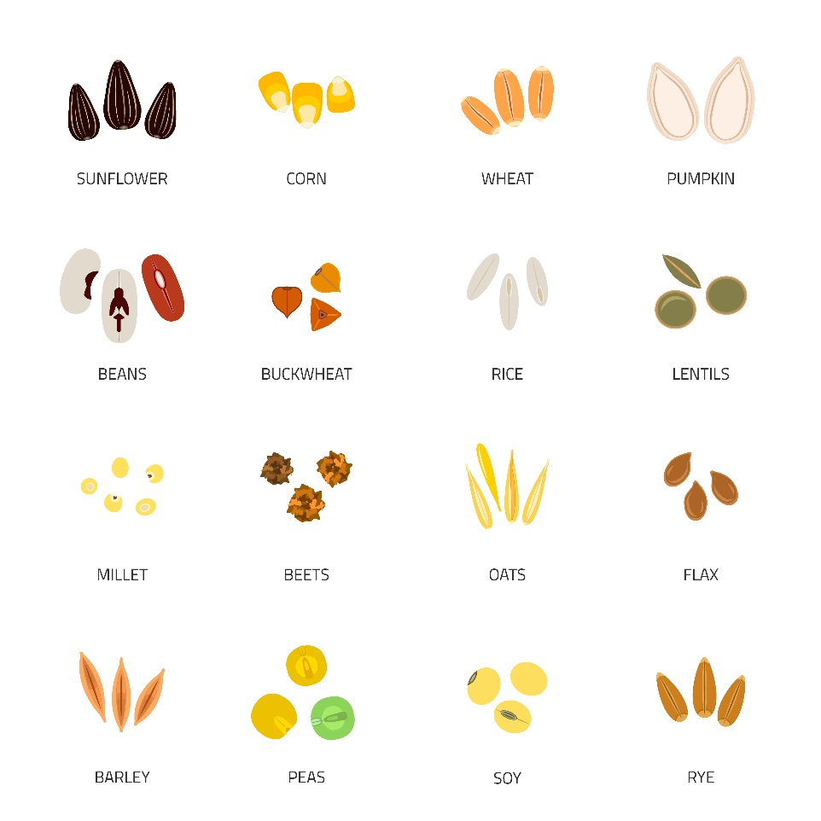
Plant and Seed Multiplication
Plant and seed multiplication is the continuous process in which plant products are grown according to defined standards and requirements to ensure genetic identity, maintain varietal purity, and meet certain quality standards before distribution to growers. In many countries, seed multiplication is part of a legally sanctioned system for quality control of seed production. In those countries where seed registration and/or certification are required by law, there are generally four recognized stages of seed multiplication: breeder seed, foundation seed, registered seed, and certified seed. These are also recognized by the OECD Seed Schema as Pre-Basic (breeder seed), Basic (Foundation/Registered seed), and Certified seed.
Even in countries that do not require formal registration and certification, the following definitions are generally recognized as the different stages of seed multiplication. Breeder seed is directly controlled by the originating or sponsoring plant-breeding organization. The first increase of breeder seed is usually referred to as foundation seed; it is handled to maintain specific genetic identity and purity. Registered seed is the progeny of breeder or foundation seed and is handled to maintain satisfactory genetic purity and identity. Certified seed is the last stage in the seed multiplication process and is generally produced from foundation or registered seed. Certified seed is the class of seed generally recommended for and used in commercial crop production.
Notes:
*This document defines plant as any plant (including plant part) for or capable of propagation. Various references are made to seed or seed production methods and crop management. It is recognized that systems exist where plant production may be accomplished through non-seed-based methods such as vegetative propagation, and therefore the use of the term “seed” is not meant to limit the scope of this document

Slide 3
Plant and Seed Multiplication
Analyze Product Integrity Concerns
Determine Critical Control Points
Establish and Implement:
Preventive Measures
Monitoring and Verification Procedures
Corrective Measures
Incident Escalation and Response Procedures
Record Keeping and Documentation Procedures
Notes:
The construct used to transform the host plant is typically comprised of one or more genes of interest coupled with specific regulating elements (e.g., promoters, terminators, transit peptides, etc.).
It is usual practice to identify or confirm the identity of the coding and non-coding sequences that will be inserted into the host genome.

Slide 4
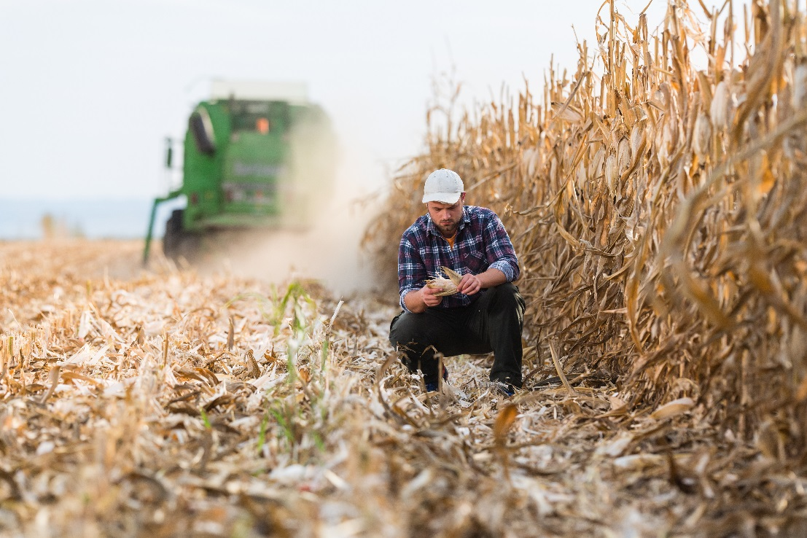
Plant and Seed Multiplication
Analyze Product Integrity Concerns
Ensure isolation is adequate to prevent unintended outcrossing, Identification: ensure proper ID of material planted and harvested, etc.
Misidentification of plant material to be planted
Misidentification of plant material harvested and retained
Inadvertent physical mixture of plant material
Errors in disposition
Ensure adequate clean-out of planting, harvesting, transporting, and conveying equipment, and storage facilities cleanout to prevent commingling.
Notes:
*In the United States, all seed production prior to commercial authorization must be done under a USDA permit or notification, and when applicable, EPA authorization in the context of a confined field trial.
*Unauthorized refers to biotechnology-derived plant material that has not been authorized by the relevant competent authority for release into the environment for purpose of cultivation or for use in the food and feed chains.

Slide 5
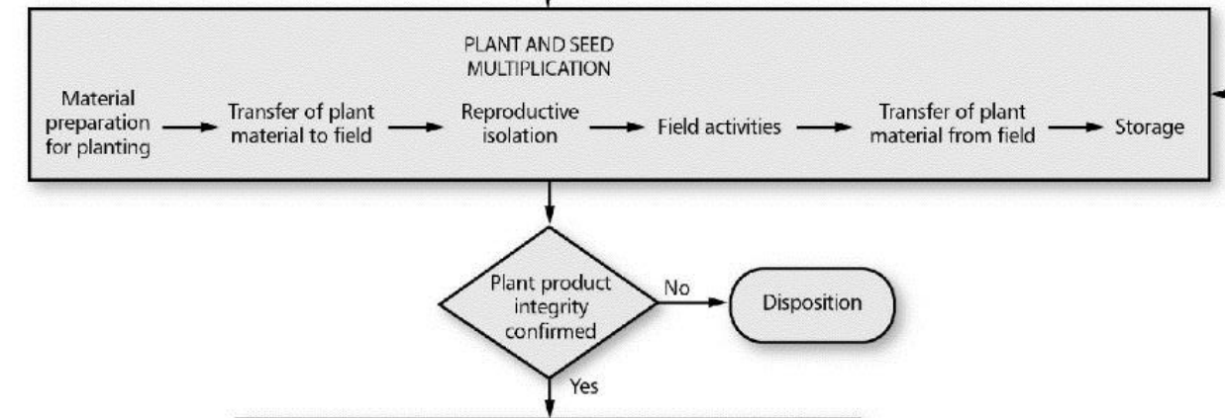
Plant and Seed Multiplication
Determine Critical Control Points
Seed packaging, storage, preparation of plant material for planting
Transfer of plant material to the field for planting
Disposal of regulated/stewarded treated seed
Confirmation of reproductive isolation, as necessary
Plant pollination, harvesting, crop destruction, post-harvest monitoring, as necessary
Transfer of plant material from the field for cleaning, conditioning, packaging, storage or transport
Storage
Alternative uses for grain if key import authorizations have not been received (e.g. feed on farm, ethanol production)

Slide 6
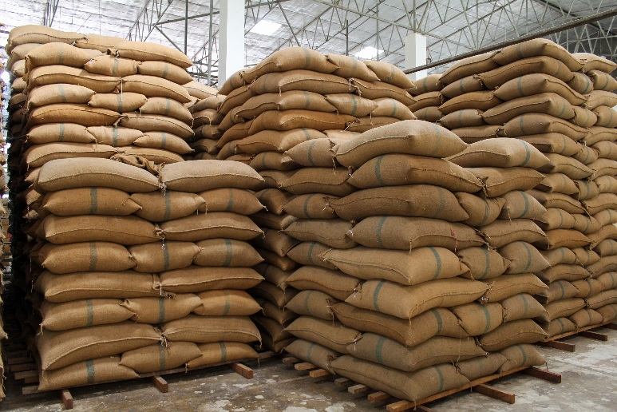
Plant and Seed Multiplication
Establish and Implement:
Preventive Measures
Effective process and procedure descriptions supported by robust training records
Quality assurance and control processes to ensure seeds are properly tested, results recorded
Labeling, tracking, and disposition of plant material as part of an inventory system
Procedures so that labels used to identify seeds or plants are recorded and information pertinent to identity is retrievable
Internal work processes and SOPs for traceability
Transfer protocols or processes for traceability across functions, departments, organizations, or locations
Methods and controls for reproductive isolation, as necessary (e.g., compliance with national standards for production of breeder, foundation, registered, and certified seed)
Methods and controls for appropriate equipment cleaning and sanitation
Methods and controls for appropriate seed storage, shipment and disposal
Training for individuals involved with activities related to plant and seed multiplication including confined field trials, if applicable
Notes:
*For the purposes of this module, labeling means to affix with a label (e.g., seed bag tag) that is marked with a name and/or other information that can be used to facilitate confirmation of plant product identity

Slide 7
Plant and Seed Multiplication
Establish and Implement:
Monitoring & Verification Procedures
Confirm:
Seed or plant identity prior to transfer of seed or plant material to the field
Seed or plant identity and assessment of transgenic purity of seed or plant material from the field by documentation or by diagnostic methods where appropriate (this applies to plant material that may be used for further multiplication or planting)
Establish and implement methods and controls for appropriate postharvest monitoring requirements
Seed or plant identity during storage or shipment
Monitor the seed multiplication program to confirm that management practices (including reproductive isolation) are in place to meet internal operational requirements and external (e.g., seed certification agencies) standards for breeder, foundation, registered and certified seed
Notes:
*For the purpose of this Guide and unless otherwise indicated, confirmation of identity may be achieved using either procedural confirmation (e.g., documentation) or analytical confirmation (e.g., laboratory assays) or both. This will be determined based on individual circumstances and may warrant a case-bycase assessment.

Slide 8
Plant and Seed Multiplication
Establish and Implement:
Corrective Measures
When a plant is misidentified, a plant is correctly identified but is not the desired genotype, or when identity cannot be confirmed, the plant material and any derivatives should be reviewed and appropriate disposition determined
Correct any deficiencies identified that could affect the reproductive isolation of the field sites and assess impact on plant product integrity
Incorporate any corrective measures or procedural changes into SOPs as appropriate
Notes:
Verify the integrity of the construct as designed.
Confirm identity prior to transfer for plant transformation.
In the event that a construct is found to be incorrectly identified or where identity cannot be confirmed, review and determine the disposition of the construct and derivations.
Incorporate any corrective measures or procedural changes into work processes and SOPs as appropriate.
Documentation of identity and traceback should be secure, accessible, and retained as appropriate

Slide 9
Plant and Seed Multiplication
Establish and Implement:
d) Incident Escalation and Response Procedures
Establish and implement appropriate incident response protocol to ensure timely and accurate reporting of corrective actions
Documentation to ensure that personnel are trained to support robust systems to report and escalate any incidents of loss of control or containment of biotechnology-derived traits
Notes:
Verify the integrity of the construct as designed.
Confirm identity prior to transfer for plant transformation.
In the event that a construct is found to be incorrectly identified or where identity cannot be confirmed, review and determine the disposition of the construct and derivations.
Incorporate any corrective measures or procedural changes into work processes and SOPs as appropriate.
Documentation of identity and traceback should be secure, accessible, and retained as appropriate

Slide 10
Plant and Seed Multiplication
Establish and Implement:
e) Record Keeping and Documentation Procedures
Documentation of production, identity and traceability should be secure, accessible, and retained as appropriate
Procedures for the retention of documentation related to non-conformities and follow up actions
Notes:
Verify the integrity of the construct as designed.
Confirm identity prior to transfer for plant transformation.
In the event that a construct is found to be incorrectly identified or where identity cannot be confirmed, review and determine the disposition of the construct and derivations.
Incorporate any corrective measures or procedural changes into work processes and SOPs as appropriate.
Documentation of identity and traceback should be secure, accessible, and retained as appropriate

Slide 11
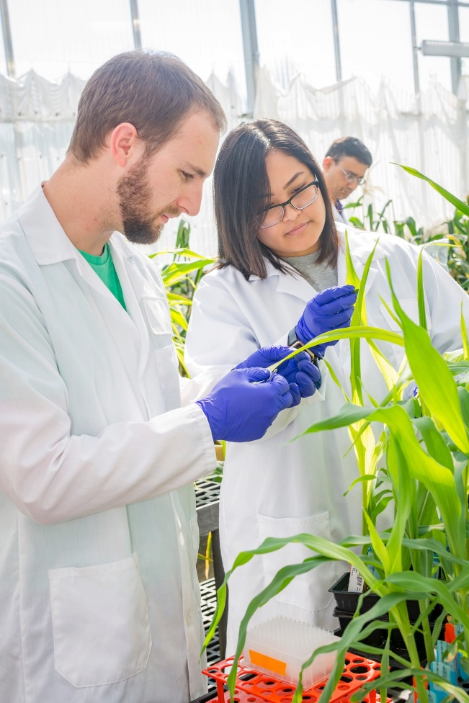
Plant and Seed Multiplication
Other Stewardship Considerations
Biology of the host plant/breeding protocol
Receiving environment
Implications of regulatory requirements
Operating procedures
Notes:
The construct used to transform the host plant is typically comprised of one or more genes of interest coupled with specific regulating elements (e.g., promoters, terminators, transit peptides, etc.).
It is usual practice to identify or confirm the identity of the coding and non-coding sequences that will be inserted into the host genome.

