Slide 1
Maintaining Plant Product Integrity

Slide 2
Disclaimer
It is the responsibility of any user of this information to consider that user’s specific circumstances (1) when developing a stewardship program specific to its organization, and (2) in meeting any applicable legal requirements. This PowerPoint presentation is not, and should not be used as, a substitute for (1) a user’s own individual understanding of its legal requirements, (2) consultation by a user with its legal counsel and other advisors, or (3) direct contact with appropriate regulatory agencies.
The information provided does not define or create legal rights or obligations, and Excellence Through Stewardship® (ETS) specifically disclaims any such rights or obligations. ETS and its members (including the speaker(s) & their organization(s) if applicable) do not make any warranties or representations, either express or implied, with respect to the accuracy or completeness of the information contained herein, or the sufficiency of the general procedures and processes contained herein to eliminate risk inherent in the referenced operations or processes; nor do they assume any liability of any kind whatsoever resulting from the use of or reliance upon any information, procedures, conclusions, or opinions contained. ETS assumes no responsibility to update this PowerPoint presentation.
Published July 2023
© 2023 Excellence Through Stewardship. All Rights Reserved.

Slide 3
Disclaimer
All examples presented (“Examples”) are solely an educational tool and not required documentation that may provide guidance to assist users in developing and implementing their own organization-specific process.
The Examples included are flexible and their application will differ according to the size, nature and complexity of the organization and products involved. The Examples are representative and not exhaustive. It is the responsibility of any user of these Examples to consider that user’s specific circumstances (1) when developing a process specific to its organization, and (2) in meeting any applicable legal requirements.
These Examples are not, and should not be used as, a substitute for (1) a user’s own individual understanding of its legal requirements, (2) consultation by a user with its legal counsel and other advisors, or (3) direct contact with appropriate regulatory agencies.
The Examples do not define or create legal rights or obligations, and Excellence Through Stewardship (ETS) specifically disclaims any such rights or obligations. ETS and its members do not make any warranties or representations, either express or implied, with respect to the accuracy or completeness of the information contained in these Examples, or the sufficiency of the general procedures and processes contained herein to eliminate risk inherent in the referenced operations or processes; nor do they assume any liability of any kind whatsoever resulting from the use of or reliance upon any information, procedures, conclusions, or opinions contained in these Examples. ETS assumes no responsibility to update these Examples.

Slide 4
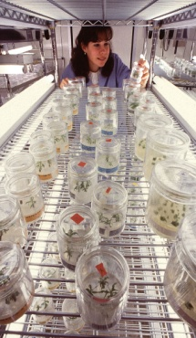
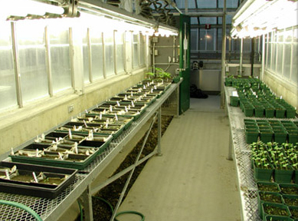
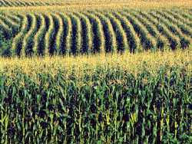
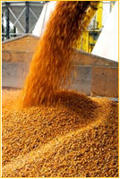
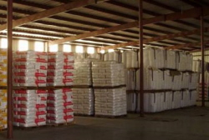
Maintaining Plant Product Integrity
Activities: Module by Module
Research in the Laboratory
Research in Containment Facilities
Confined
Field Trials
Plant and Seed Multiplication
Commercial Plant and Seed Distribution

Slide 5
Commercial Plant and Seed Distribution
Maintaining plant product integrity remains important in commercial seed because regulatory authorizations may not be granted at the same time in all countries. Prior to the commercial introduction or distribution of any biotechnology-derived plant or seed, the product developer or its licensee should have obtained all necessary regulatory authorizations as a prerequisite to market launch in a manner consistent with the Guide for Product Launch Stewardship. These may include environmental, food and feed safety authorizations as well as any other requirements under national seed and/or phytosanitary regulations. If the product is intended for food or feed use, plan to make an appropriate detection method or test commercially available to confirm plant product integrity.
The entire distribution channel for a biotechnology-derived plant product is often not controlled by one entity; but rather by a number of entities involved with production, storage, conditioning, processing, sales, and distribution to customers. Therefore, a single entity will not likely be involved in all steps of the production and distribution process for biotechnology-derived plant products. However, each entity is responsible for those steps that are within its scope of operation.
Notes:
This document defines plant as any plant (including plant part) for or capable of propagation. Various references are made to seed and/or seed production methods and crop management. It is recognized that systems exist where plant production may be accomplished through non-seed based methods such as vegetative propagation and therefore the use of the term “seed” is not meant to limit the scope of this document

Slide 6
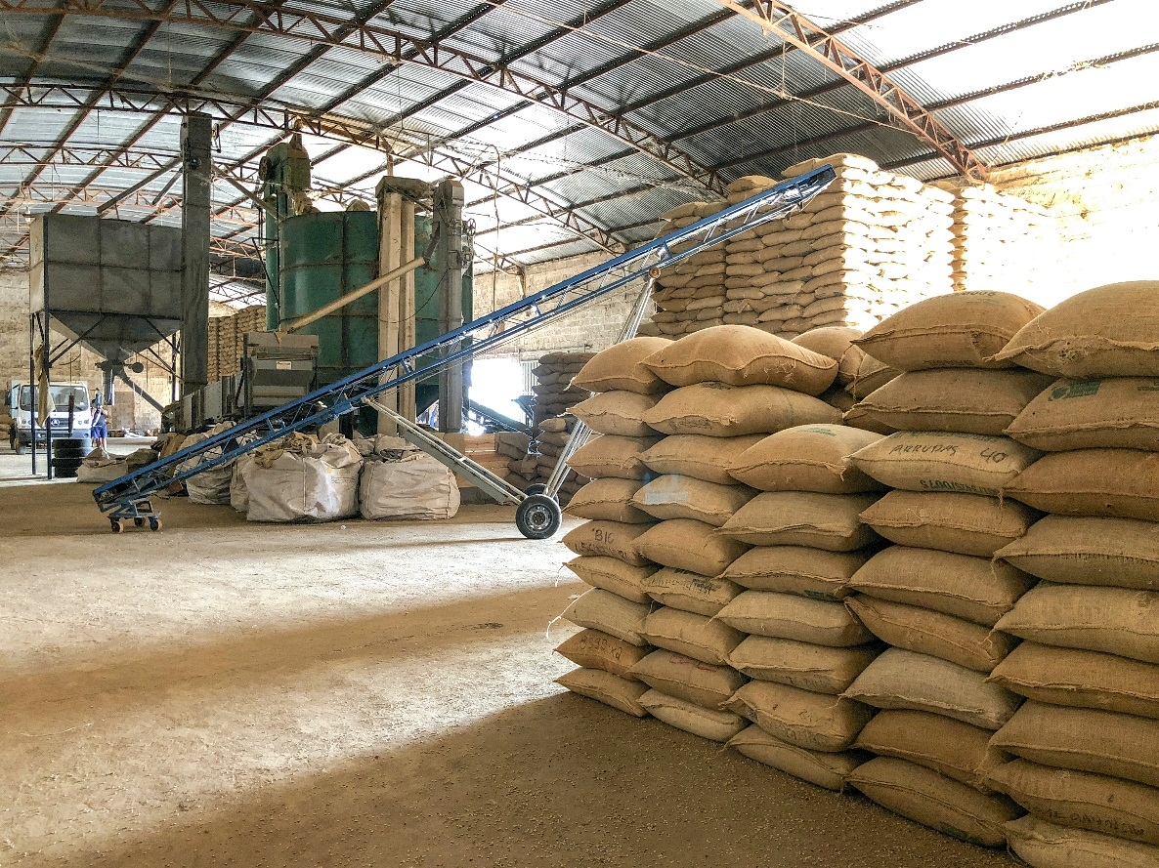
Commercial Plant and Seed Distribution
This module provides guidance for developers, producers, licensees and distributors of biotechnology-derived plant or seed products for activities associated with the introduction or distribution of biotechnology-derived plant or seed products into commercial distribution channels and markets. The scope of this module includes activities to process, condition, treat, store and package products resulting from seed and plant multiplication. Other activities potentially covered in this module include determining purity of the seed lot, the movement or transport of materials from production or processing locations to and from subsequent processing or storage locations prior to commercial distribution, and storage and control of products and inventory in various stages of processing and packaging prior to commercial distribution. The final activities covered include the transport of finished products to commercial points-of-sale for subsequent sale and distribution and the distribution of products through markets to customers.
When working with third parties (e.g., service contractors, research contractors, technology transfer licensees) it is important that agreements include stewardship and quality management provisions to maintain plant product integrity.
Notes:
This document defines plant as any plant (including plant part) for or capable of propagation. Various references are made to seed and/or seed production methods and crop management. It is recognized that systems exist where plant production may be accomplished through non-seed based methods such as vegetative propagation and therefore the use of the term “seed” is not meant to limit the scope of this document

Slide 7
Commercial Plant and Seed Distribution
Analyze Product Integrity Concerns
Determine Critical Control Points
Establish and Implement:
Preventive Measures
Monitoring and Verification Procedures
Corrective Measures
Incident Escalation and Response Procedures
Record Keeping and Documentation Procedures
Notes:
The construct used to transform the host plant is typically comprised of one or more genes of interest coupled with specific regulating elements (e.g., promoters, terminators, transit peptides, etc.).
It is usual practice to identify or confirm the identity of the coding and non-coding sequences that will be inserted into the host genome.

Slide 8
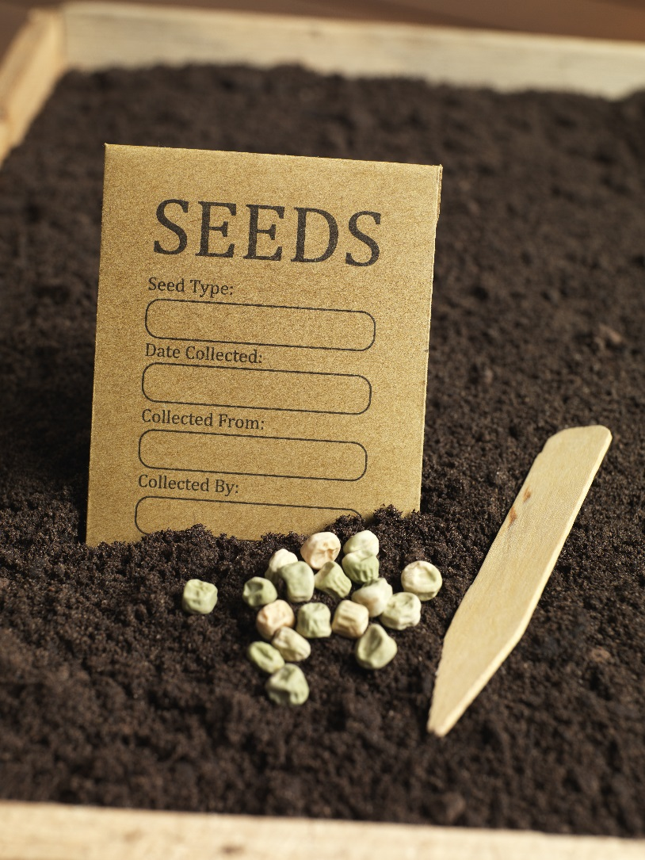
Commercial Plant and Seed Distribution
Analyze Product Integrity Concerns
Errors in product identity
Errors in trait purity
Presence of unintended traits
Inadvertent physical mixture of plant material
Notes:
This document defines trait purity as a measure of the extent to which the desired trait is present and unintended traits are absent in a material.

Slide 9
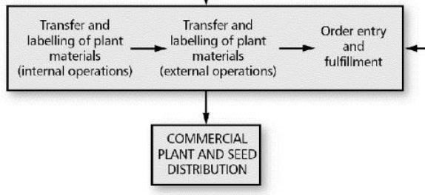
Commercial Plant and Seed Distribution
Determine Critical Control Points
Transfer and labeling of plant materials for cleaning, conditioning, packaging, storage and/or transport within the organization
Transfer and labeling of plant materials for cleaning, conditioning, packaging, storage and/or transport to interim or final destinations external to the organization
Order entry and fulfillment for materials to be distributed

Slide 10
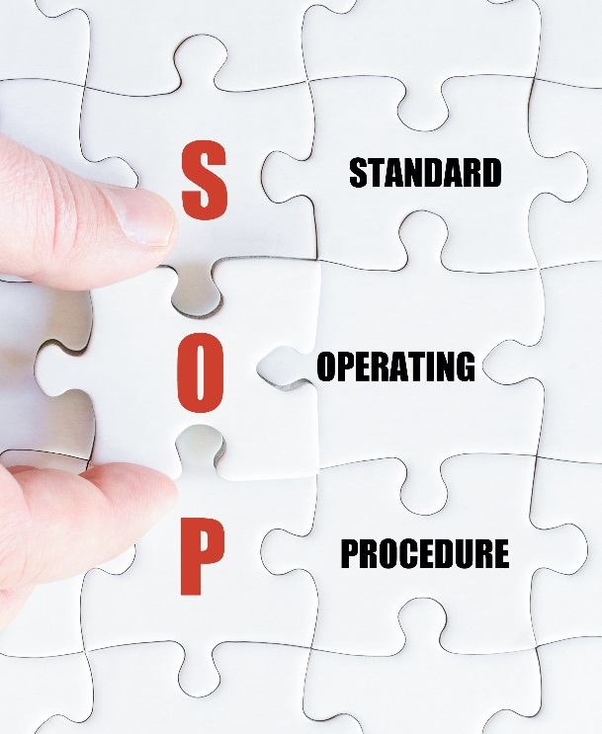
Commercial Plant and Seed Distribution
Establish and Implement:
Preventive Measures
Define appropriate seed quality standards to be achieved in order that plants/seeds are suitable for their intended use
Implement an appropriate quality control strategy to ascertain seed quality standards are being fulfilled
Labeling, tracking, and disposition of plant material as part of an inventory system for activities up to and including the point of commercial distribution
Procedures so that information used to identify plant products is recorded on labels and associated with documentation pertinent to identity and production history
Internal work processes and SOPs for traceability
Transfer protocols or processes for traceability across functions, departments, organizations and locations
Protocols and processes for equipment cleaning and inspection to avoid inadvertent physical mixture (dedicated equipment should be considered where appropriate)
Seed processing, warehousing, and distribution processes to maintain plant product integrity and avoid inadvertent physical mixture
Notes:
*For the purposes of this module, labeling means to affix with a label (e.g., seed bag tag) that is marked with a name and/or other information that can be used to facilitate confirmation of plant product identity

Slide 11
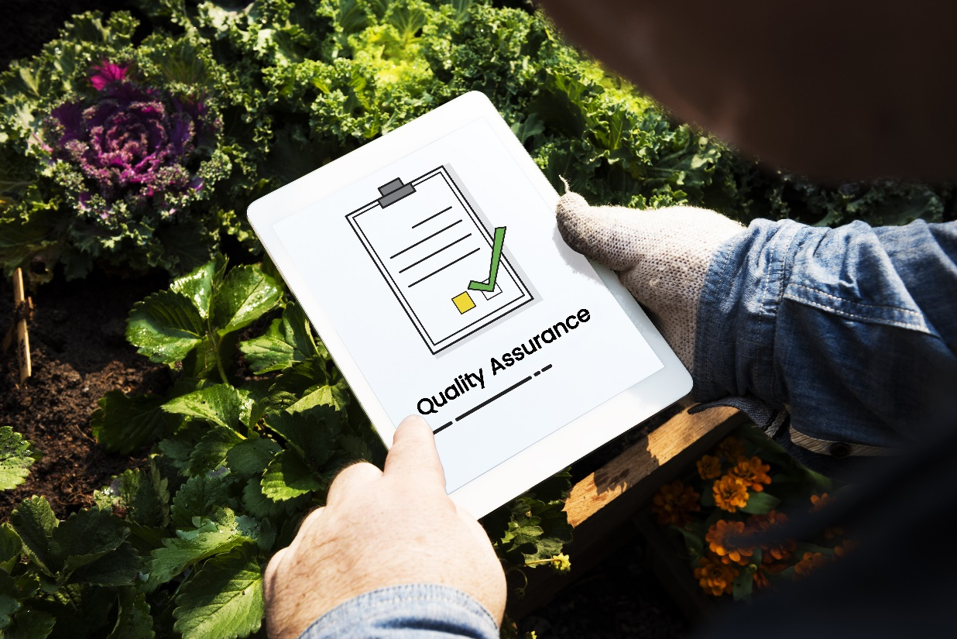
Commercial Plant and Seed Distribution
Establish and Implement:
Monitoring & Verification Procedures
Confirm plant identity prior to cleaning, packaging, and transport by documentation or verify using diagnostic methods where appropriate
Verify that the plant product meets the quality standard for intended use
Notes:
For the purpose of the Guide for Maintaining Plant Product Integrity for Biotechnology-Derived Plant Products and unless otherwise indicated, confirmation of identity may be achieved using either procedural confirmation (e.g., documentation) or analytical confirmation (e.g., laboratory assays) or both. This will be determined based on individual circumstances and may warrant a case-by-case assessment.

Slide 12
Commercial Plant and Seed Distribution
Establish and Implement:
Corrective Measures
Establish and implement processes for product containment, withdrawal and recall
If plant material is misidentified, correctly identified but not the desired genotype, or where identity cannot be confirmed, determine appropriate disposition of the plant material and any derivatives
Establish and implement processes for receiving, controlling and determining the disposition of returned materials
Incorporate procedural changes into standard operating procedures to prevent recurrence of non-conformities
If applicable, train personnel on procedural changes incorporated
Notes:
Verify the integrity of the construct as designed.
Confirm identity prior to transfer for plant transformation.
In the event that a construct is found to be incorrectly identified or where identity cannot be confirmed, review and determine the disposition of the construct and derivations.
Incorporate any corrective measures or procedural changes into work processes and SOPs as appropriate.
Documentation of identity and traceback should be secure, accessible, and retained as appropriate

Slide 13
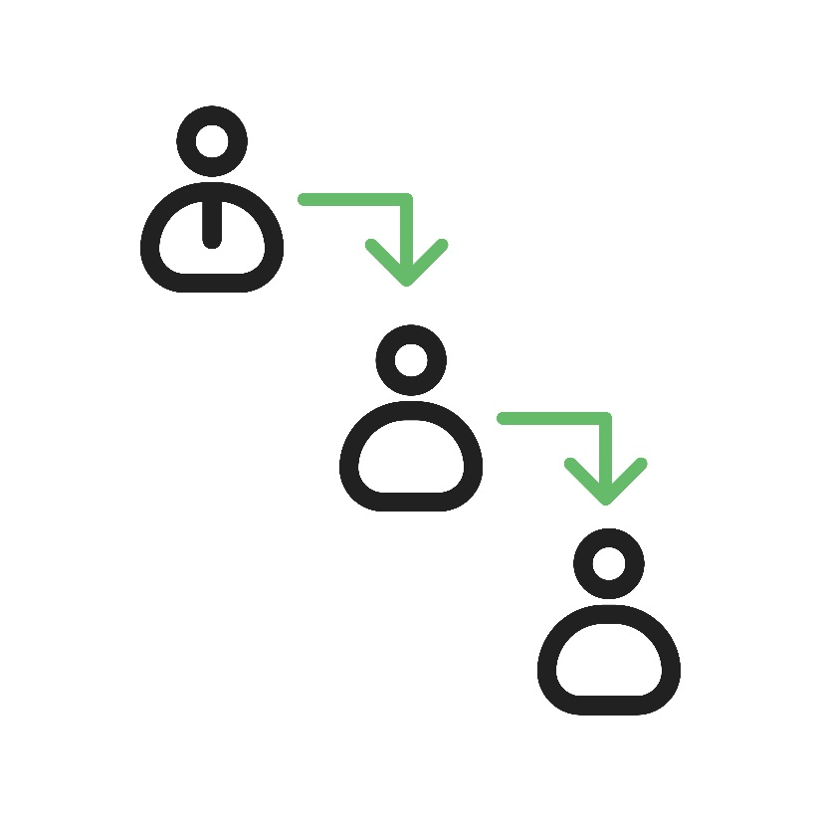
Commercial Plant and Seed Distribution
Establish and Implement:
d) Incident Escalation and Response Procedures
Documentation to ensure that personnel are trained to support robust systems to report and escalate any incidents of loss of control or containment of GM traits
Incorporate appropriate incident response protocols to ensure timely and accurate reporting of corrective actions
Notes:
Verify the integrity of the construct as designed.
Confirm identity prior to transfer for plant transformation.
In the event that a construct is found to be incorrectly identified or where identity cannot be confirmed, review and determine the disposition of the construct and derivations.
Incorporate any corrective measures or procedural changes into work processes and SOPs as appropriate.
Documentation of identity and traceback should be secure, accessible, and retained as appropriate

Slide 14
Commercial Plant and Seed Distribution
Establish and Implement:
e) Record Keeping and Documentation Procedures
Procedures so that documentation of production, processing, distribution, identity and traceability is secure, accessible, and retained as appropriate
Procedures for the retention of documentation related to non-conformities and follow up actions
Notes:
Verify the integrity of the construct as designed.
Confirm identity prior to transfer for plant transformation.
In the event that a construct is found to be incorrectly identified or where identity cannot be confirmed, review and determine the disposition of the construct and derivations.
Incorporate any corrective measures or procedural changes into work processes and SOPs as appropriate.
Documentation of identity and traceback should be secure, accessible, and retained as appropriate

Slide 15
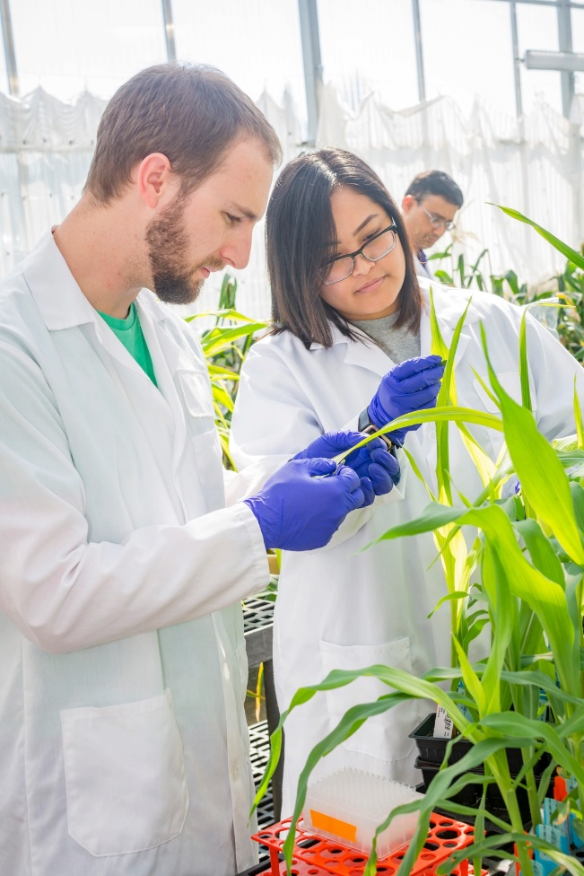
Commercial Plant and Seed Distribution
Other Stewardship Considerations
Biology of the host plant/breeding protocol
Receiving environment
Implications of regulatory requirements
Operating procedures
Notes:
The construct used to transform the host plant is typically comprised of one or more genes of interest coupled with specific regulating elements (e.g., promoters, terminators, transit peptides, etc.).
It is usual practice to identify or confirm the identity of the coding and non-coding sequences that will be inserted into the host genome.

Slide 16
Commercial Plant and Seed Distribution
Examples of what could go wrong?
Loss of information (the database is out of order, with no backup)
The final host plant reveals it doesn't contain the intended construct
Loss of confinement
(e.g. Comingling with non-regulated GM)
Accidental transfer of harvested commodity to commercial grain channel
Loss of traceability
(e.g. a label is missing)
Identity control has not been performed at a critical control point
Loss of containment
Notes:
Then one could describe the types of losses of confinement:
Loss of seed in shipment
Loss of isolation measures
Border row stand loss
Saved seed activity planted closer than planned/expected
Equipment shared with saved seed activity resulting in commingling
Equipment not sufficiently cleaned
Then used for another activity
Comingling with non-regulated GM
Loss of seed during transport of equipment following planting/harvest
Pollen flow not mitigated sufficiently. Viable pollen from reg-GM or non-commercial GM activity reaches and successfully pollinates commercial crop or saved seed activity in compatible species.
Accidental harvest
Accidental transfer of harvested commodity to commercial grain channel

Slide 17
Commercial Plant and Seed Distribution
Examples of what could go wrong?
USDA’s two most common permit condition noncompliance’s:
Notes:
Then one could describe the types of losses of confinement:
Loss of seed in shipment
Loss of isolation measures
Border row stand loss
Saved seed activity planted closer than planned/expected
Equipment shared with saved seed activity resulting in commingling
Equipment not sufficiently cleaned
Then used for another activity
Comingling with non-regulated GM
Loss of seed during transport of equipment following planting/harvest
Pollen flow not mitigated sufficiently. Viable pollen from reg-GM or non-commercial GM activity reaches and successfully pollinates commercial crop or saved seed activity in compatible species.
Accidental harvest
Accidental transfer of harvested commodity to commercial grain channel

