Slide 1
Maintaining Plant Product Integrity

Slide 2
Disclaimer
It is the responsibility of any user of this information to consider that user’s specific circumstances (1) when developing a stewardship program specific to its organization, and (2) in meeting any applicable legal requirements. This PowerPoint presentation is not, and should not be used as, a substitute for (1) a user’s own individual understanding of its legal requirements, (2) consultation by a user with its legal counsel and other advisors, or (3) direct contact with appropriate regulatory agencies.
The information provided does not define or create legal rights or obligations, and Excellence Through Stewardship® (ETS) specifically disclaims any such rights or obligations. ETS and its members (including the speaker(s) & their organization(s) if applicable) do not make any warranties or representations, either express or implied, with respect to the accuracy or completeness of the information contained herein, or the sufficiency of the general procedures and processes contained herein to eliminate risk inherent in the referenced operations or processes; nor do they assume any liability of any kind whatsoever resulting from the use of or reliance upon any information, procedures, conclusions, or opinions contained. ETS assumes no responsibility to update this PowerPoint presentation.
Published July 2023
© 2023 Excellence Through Stewardship. All Rights Reserved.

Slide 3
Disclaimer
All examples presented (“Examples”) are solely an educational tool and not required documentation that may provide guidance to assist users in developing and implementing their own organization-specific process.
The Examples included are flexible and their application will differ according to the size, nature and complexity of the organization and products involved. The Examples are representative and not exhaustive. It is the responsibility of any user of these Examples to consider that user’s specific circumstances (1) when developing a process specific to its organization, and (2) in meeting any applicable legal requirements.
These Examples are not, and should not be used as, a substitute for (1) a user’s own individual understanding of its legal requirements, (2) consultation by a user with its legal counsel and other advisors, or (3) direct contact with appropriate regulatory agencies.
The Examples do not define or create legal rights or obligations, and Excellence Through Stewardship (ETS) specifically disclaims any such rights or obligations. ETS and its members do not make any warranties or representations, either express or implied, with respect to the accuracy or completeness of the information contained in these Examples, or the sufficiency of the general procedures and processes contained herein to eliminate risk inherent in the referenced operations or processes; nor do they assume any liability of any kind whatsoever resulting from the use of or reliance upon any information, procedures, conclusions, or opinions contained in these Examples. ETS assumes no responsibility to update these Examples.

Slide 4
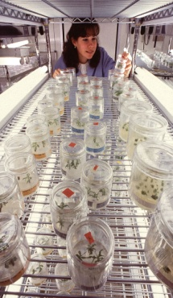
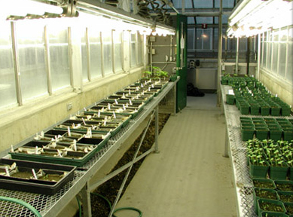
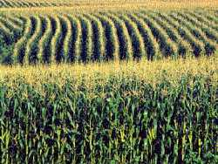
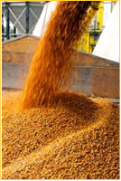
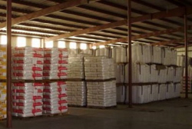
Maintaining Plant Product Integrity
Activities: Module by Module
Research in the Laboratory
Research in Containment Facilities
Confined
Field Trials
Plant and Seed Multiplication
Commercial Plant and Seed Distribution

Slide 5

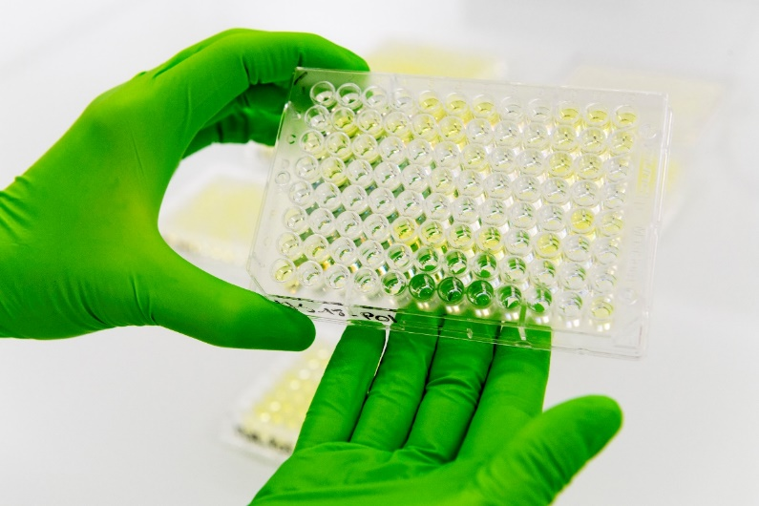
Research in the Laboratory
Government regulations and guidance pertinent to working with recombinant-DNA molecules, microorganisms, and plants should be incorporated into standard operating procedures.
Identify or confirm the identity of the coding and non-coding sequences that will be inserted into the host genome.
Notes:
The first stages in the development of a biotechnology-derived plant take place in the contained environment of a laboratory and include activities related to construct development and plant transformation.
The construct used to transform the host plant is typically comprised of one or more genes of interest coupled with specific regulating elements (e.g., promoters, terminators, transit peptides, etc.).
It is usual practice to identify or confirm the identity of the coding and non-coding sequences that will be inserted into the host genome.

Slide 6
Research in the Laboratory
Construct Development
Analyze Product Integrity Concerns
Determine Critical Control Points
Establish and Implement:
  Preventive Measures
  Monitoring and Verification Procedures
  Corrective Measures
  Record Keeping and Documentation Procedures
Notes:
The construct used to transform the host plant is typically comprised of one or more genes of interest coupled with specific regulating elements (e.g., promoters, terminators, transit peptides, etc.).
It is usual practice to identify or confirm the identity of the coding and non-coding sequences that will be inserted into the host genome.

Slide 7
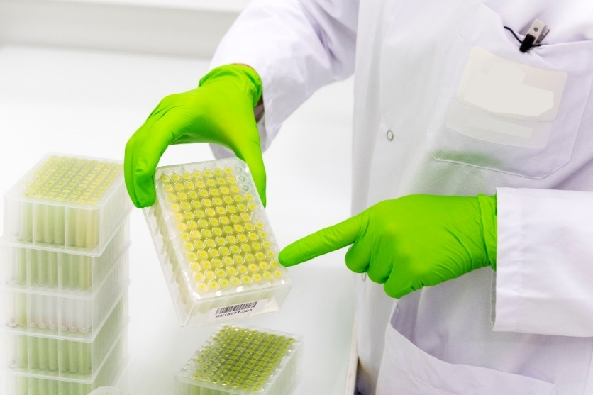
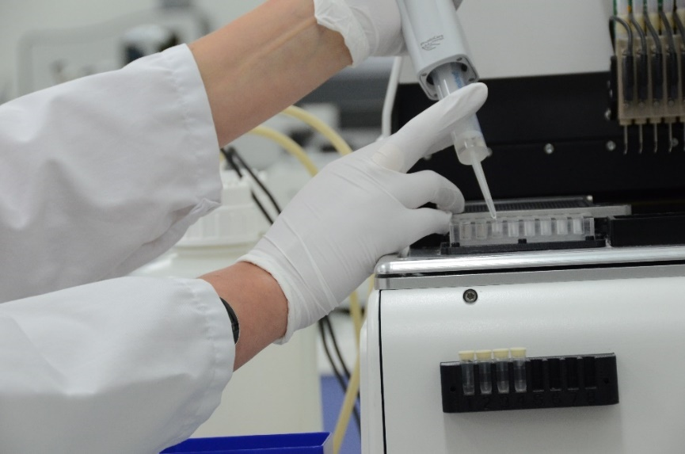
Research in the Laboratory
Construct Development
Analyze Product Integrity Concerns
  Misidentification of construct
  Mislabeling
  Errors in tracking
  Errors in disposition
Determine Critical Control Points
  Design and creation of construct with appropriate genetic elements
  Confirmation of content and organization of construct
  Transfer of construct to plant transformation

Slide 8
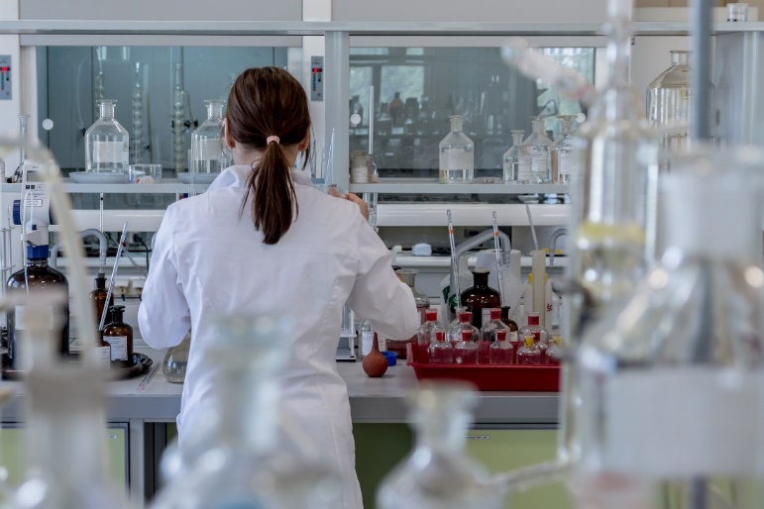
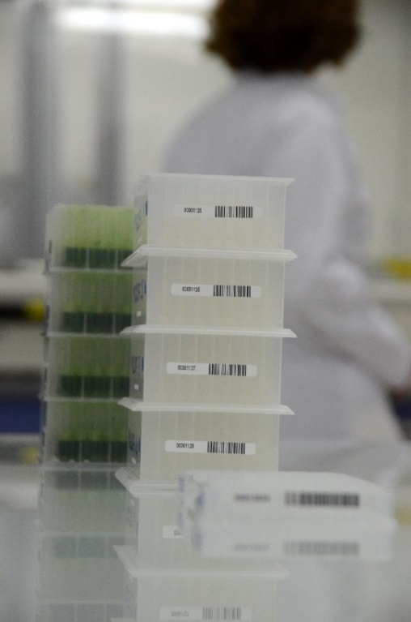
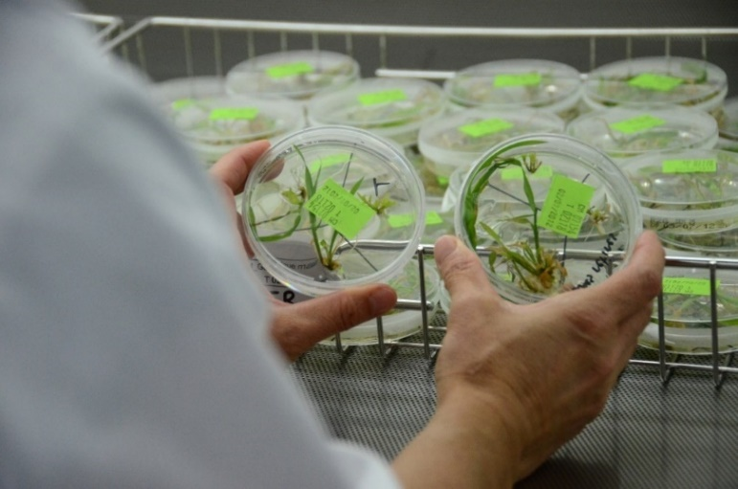
Research in the Laboratory
Construct Development
Establish and Implement:
  Preventive Measures
    Process for the design prior to production
    Verification of the identity and integrity
    Labeling, tracking and disposition within and inventory system
    Procedures to record identification labels and to retrieve the information
    Internal work processes and documentation for traceability
Notes:
Process for the design of the construct prior to production.
Verification of the identity (e.g., sequencing, restriction endonuclease mapping, polymerase chain reaction using construct-specific oligonucleotides, Southern blot with construct-specific probes, or other appropriate methods).
Labelling, tracking, and disposition as part of an inventory system.
Procedures so that labels used to identify a construct are recorded and information pertinent to the construct’s identity is retrievable.
Internal work processes and SOP for traceback.

Slide 9
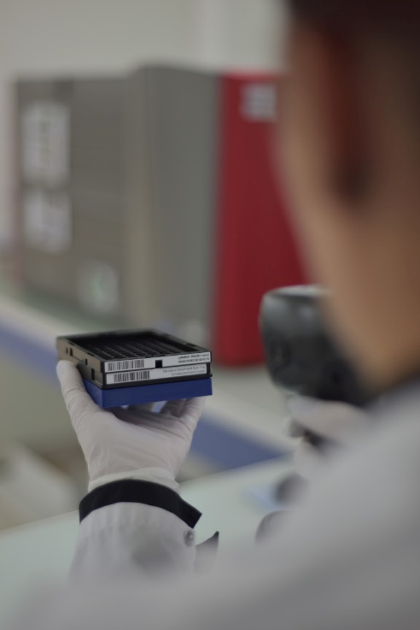
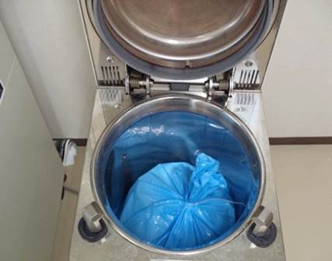
Research in the Laboratory
Construct Development
Establish and Implement:
  Monitoring & Verification Procedures
  - Verify the integrity of the construct as designed
  - Confirm identity prior to transfer for plant transformation
  Corrective Measures
  - If construct is incorrectly identified, review and determine disposition
  - Incorporate corrective measures into work processes and train personnel
Notes:
Verify the integrity of the construct as designed.
Confirm identity prior to transfer for plant transformation.
In the event that a construct is found to be incorrectly identified or where identity cannot be confirmed, review and determine the disposition of the construct and derivations.
Incorporate any corrective measures or procedural changes into work processes and SOPs as appropriate.
Documentation of identity and traceback should be secure, accessible, and retained as appropriate

Slide 10

Research in the Laboratory
Construct Development
Establish and Implement:
  Record Keeping and Documentation Procedures
- Documentation of identity and traceability should be secure, accessible and retained
Notes:
Verify the integrity of the construct as designed.
Confirm identity prior to transfer for plant transformation.
In the event that a construct is found to be incorrectly identified or where identity cannot be confirmed, review and determine the disposition of the construct and derivations.
Incorporate any corrective measures or procedural changes into work processes and SOPs as appropriate.
Documentation of identity and traceback should be secure, accessible, and retained as appropriate

Slide 11
Research in the Laboratory
Plant Transformation and Regeneration
Analyze Product Integrity Concerns
Determine Critical Control Points
Establish and Implement:
  Preventive Measures
  Monitoring and Verification Procedures
  Corrective Measures
  Incident Escalation and Response Procedures
  Record Keeping and Documentation Procedures
Notes:
The construct used to transform the host plant is typically comprised of one or more genes of interest coupled with specific regulating elements (e.g., promoters, terminators, transit peptides, etc.).
It is usual practice to identify or confirm the identity of the coding and non-coding sequences that will be inserted into the host genome.

Slide 12
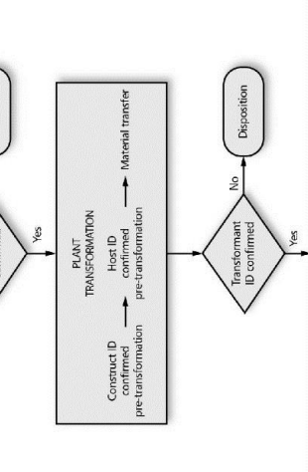
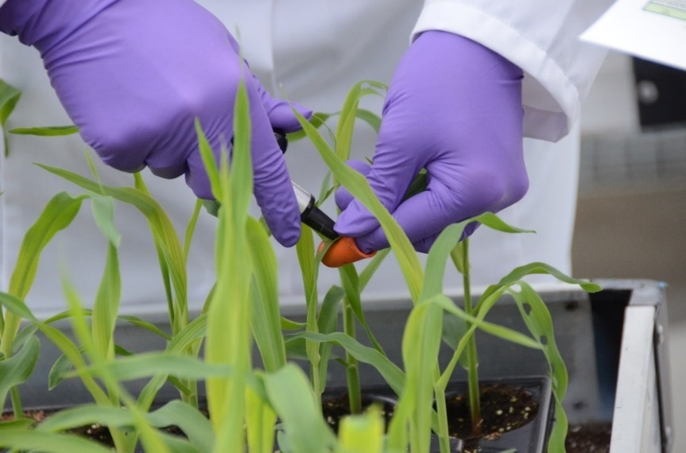
Research in the Laboratory
Plant Transformation and Regeneration
Analyze Product Integrity Concerns
  Misidentification
  Mislabeling
  Errors in tracking
  Errors in disposition, in devitalization of seed or plant tissue
Determine Critical Control Points
  Confirm identity of construction and host material prior to transformation
  Confirm identity of transformant throughout steps to regenerate plant
  Storage, transfer and disposition of regenerated plant
Notes:
Analyze Product Integrity Concerns
Misidentification
Mislabeling
Errors in tracking
Errors in disposition
Errors in devitalization / destruction of GM seed / plant tissue for cancelled or concluded projects
Determine Critical Control Points
Confirm
Construct identity prior to transformation
Host material identity prior to transformation
Identity of transformant throughout steps to regenerate plant
Storage, transfer, and disposition of regenerated plants

Slide 13
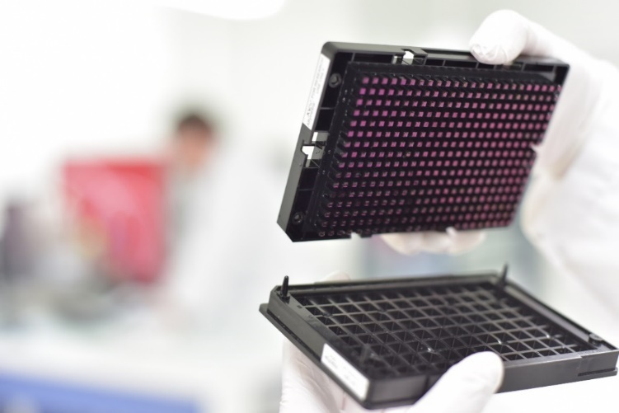

Research in the Laboratory
Plant Transformation and Regeneration
Establish and Implement:
Preventive Measures
  Labeling, tracking and disposition as part of an inventory system
  Procedures to record identification labels of host material and transformants and to retrieve the information
  Internal work processes and documentation for traceability
Monitoring and Verification Procedures
      Prior to transformation, during steps to regenerate plant or prior to transfer for further propagation: Confirm identity by documentation or diagnostic methods.
      Appropriate processes and criteria for the selection of transformants
Notes:
Preventive Measures
Labeling, tracking, and disposition of an inventory system for transformants
Procedures so that labels used to identify host materials and transformants are recorded and information pertinent to identity is retrievable
Internal work processes and SOPs for traceability
Monitoring and Verification Procedures
Prior to transformation, confirm identity of transforming DNA, host, and associated material by documentation or confirm using diagnostic methods
During steps to regenerate plant, confirm identity of transformant by documentation or confirm by diagnostic methods
Prior to transfer for further propogation, confirm identity of transformant by documentation or confirm by diagnostic methods
Appropriate processes and criteria for the selection of transformants

Slide 14
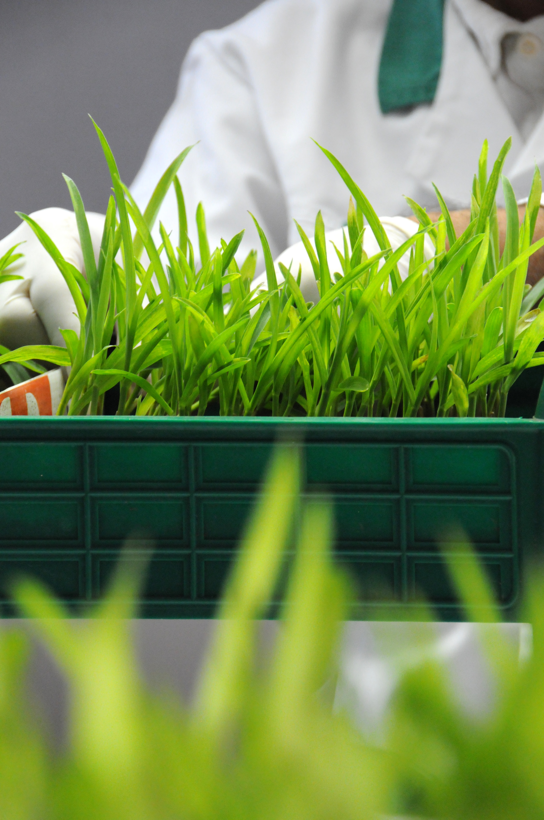
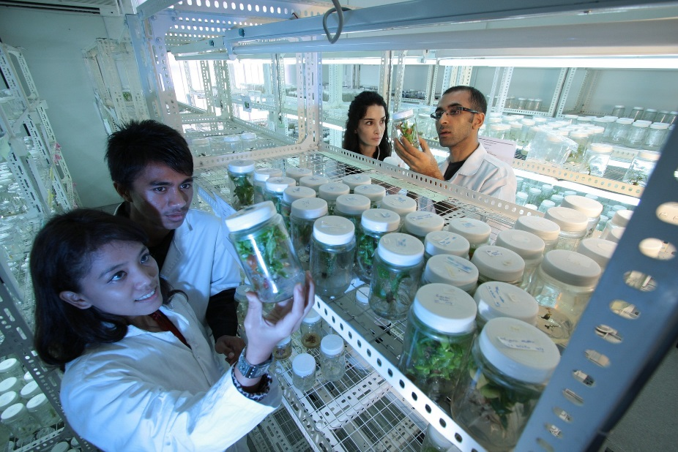
Research in the Laboratory
Plant Transformation and Regeneration
Establish and Implement:
Corrective Measures
  If material or transformant is misidentified, review and determine disposition
  Incorporate corrective measures into work processes and train personnel
Incident Escalation and Response Procedures
  Documentation to ensure personnel training to report and escalate any incident
Notes:
Corrective Measures
If the host material or the transformant is found to be incorrectly identified or the identity cannot be confirmed, review the materials and any derivatives and determine appropriate disposition
Incorporate any corrective measures or procedural changes into SOPs
Train personnel on any procedural changes
Incident Escalation and Response Procedures
Documentation to ensure that personnel are trained to support robust systems to report and escalate any incidents of loss of control or containment

Slide 15
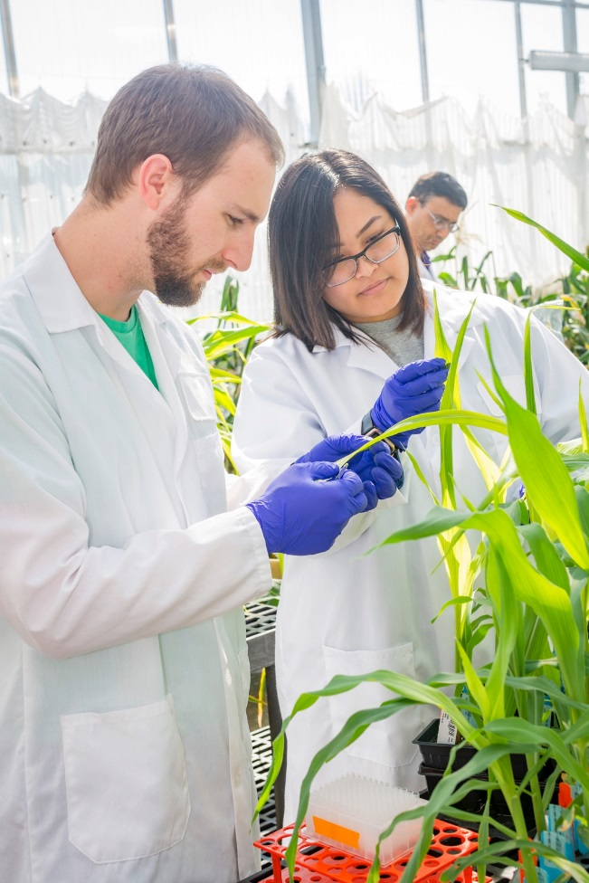
Research in the Laboratory
Plant Transformation and Regeneration
Establish and Implement:
Record keeping and documentation procedures
  Documentation of transformation, regeneration, identity and traceability, should be secure, accessible and retained
  Procedures for the retention of documentation related to non-conformities and follow up
Notes:
Record Keeping and Documentation Procedures
Documentation of transformation, regeneration, identity and traceability should be secure, accessible, and retained as appropriate
Procedures for the retention of documentation related to non-conformities and follow up actions

Slide 16

Research in the Laboratory
Examples of what could go wrong?
Loss of information (the database is out of order, with no backup)
The final host plant reveals it doesn't contain the intended construct
Loss of traceability
(e.g. a label is missing)
Identity control has not been performed at a critical control point
Loss of containment

