Slide 1
Maintaining Plant Product Integrity

Slide 2
Disclaimer
It is the responsibility of any user of this information to consider that user’s specific circumstances (1) when developing a stewardship program specific to its organization, and (2) in meeting any applicable legal requirements. This PowerPoint presentation is not, and should not be used as, a substitute for (1) a user’s own individual understanding of its legal requirements, (2) consultation by a user with its legal counsel and other advisors, or (3) direct contact with appropriate regulatory agencies.
The information provided does not define or create legal rights or obligations, and Excellence Through Stewardship® (ETS) specifically disclaims any such rights or obligations. ETS and its members (including the speaker(s) & their organization(s) if applicable) do not make any warranties or representations, either express or implied, with respect to the accuracy or completeness of the information contained herein, or the sufficiency of the general procedures and processes contained herein to eliminate risk inherent in the referenced operations or processes; nor do they assume any liability of any kind whatsoever resulting from the use of or reliance upon any information, procedures, conclusions, or opinions contained. ETS assumes no responsibility to update this PowerPoint presentation.
Published July 2023
© 2023 Excellence Through Stewardship. All Rights Reserved.

Slide 3
Disclaimer
All examples presented (“Examples”) are solely an educational tool and not required documentation that may provide guidance to assist users in developing and implementing their own organization-specific process.
The Examples included are flexible and their application will differ according to the size, nature and complexity of the organization and products involved. The Examples are representative and not exhaustive. It is the responsibility of any user of these Examples to consider that user’s specific circumstances (1) when developing a process specific to its organization, and (2) in meeting any applicable legal requirements.
These Examples are not, and should not be used as, a substitute for (1) a user’s own individual understanding of its legal requirements, (2) consultation by a user with its legal counsel and other advisors, or (3) direct contact with appropriate regulatory agencies.
The Examples do not define or create legal rights or obligations, and Excellence Through Stewardship (ETS) specifically disclaims any such rights or obligations. ETS and its members do not make any warranties or representations, either express or implied, with respect to the accuracy or completeness of the information contained in these Examples, or the sufficiency of the general procedures and processes contained herein to eliminate risk inherent in the referenced operations or processes; nor do they assume any liability of any kind whatsoever resulting from the use of or reliance upon any information, procedures, conclusions, or opinions contained in these Examples. ETS assumes no responsibility to update these Examples.

Slide 4
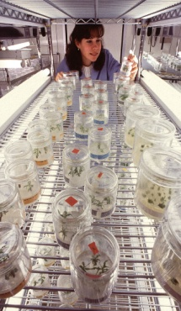
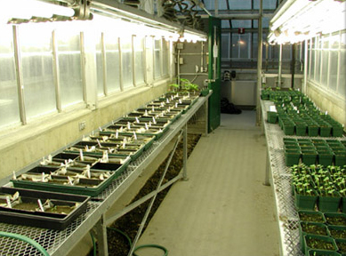
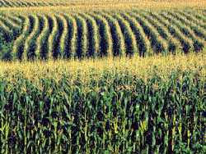
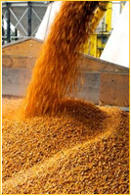
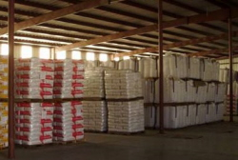
Maintaining Plant Product Integrity
Activities: Module by Module
Research in the Laboratory
Research in Containment Facilities
Confined
Field Trials
Plant and Seed Multiplication
Commercial Plant and Seed Distribution

Slide 5
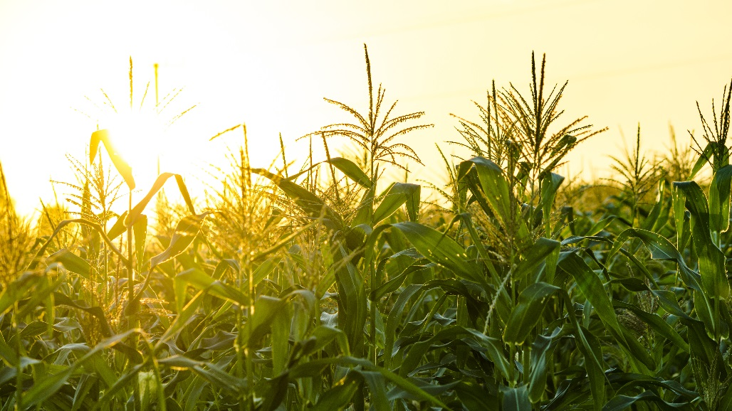
Confined Field Trials
Within the product life cycle, confined field trials represent the controlled introduction of a biotechnology-derived plant into the environment. As such, their activities are distinctly different from the work performed in containment facilities, such as laboratories, growth chambers, and greenhouses, and from the work associated with seed multiplication or commercial cultivation that occurs after product authorization by regulatory authorities.
Field trials for evaluating efficacy and agronomic performance are critical to product development, whether the product is a biotechnology or non-biotechnology crop. Being able to conduct field trials with biotechnology-derived plants is an essential part of the product development pathway. It provides developers with opportunities to collect data addressing the information requirements established by regulatory authorities for environmental, food, and feed safety assessments in the country of cultivation and key import countries. Confined field trials generally are small in scale. Larger field trials may be necessary to confirm trait and agronomic performance and to produce sufficient material for analytical tests in support of food, feed and environmental safety evaluations. Confined field trials may be used to produce breeder seed in the country of cultivation prior to authorization of the biotechnology-derived plant in key import counties with functioning regulatory systems (see Module 4).

Slide 6
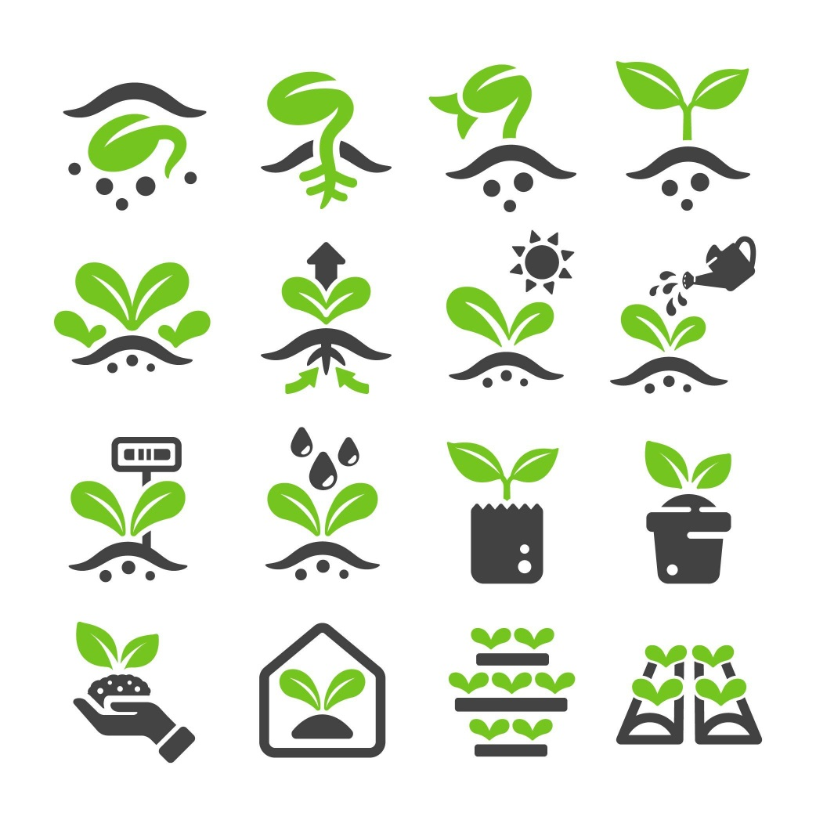
Confined Field Trials
Events may be selected for introgression of the desired trait(s) into elite germplasm. Introgression is achieved using conventional plant breeding techniques that are similar to those applied in the development of non-transgenic varieties (e.g., directed and controlled cross-pollination and selection techniques). Breeding into elite germplasm is often initiated before product authorization is received from regulatory agencies, so confinement of breeding nurseries may be necessary. As with any breeding program, it is critical that plant product integrity be maintained.

Slide 7
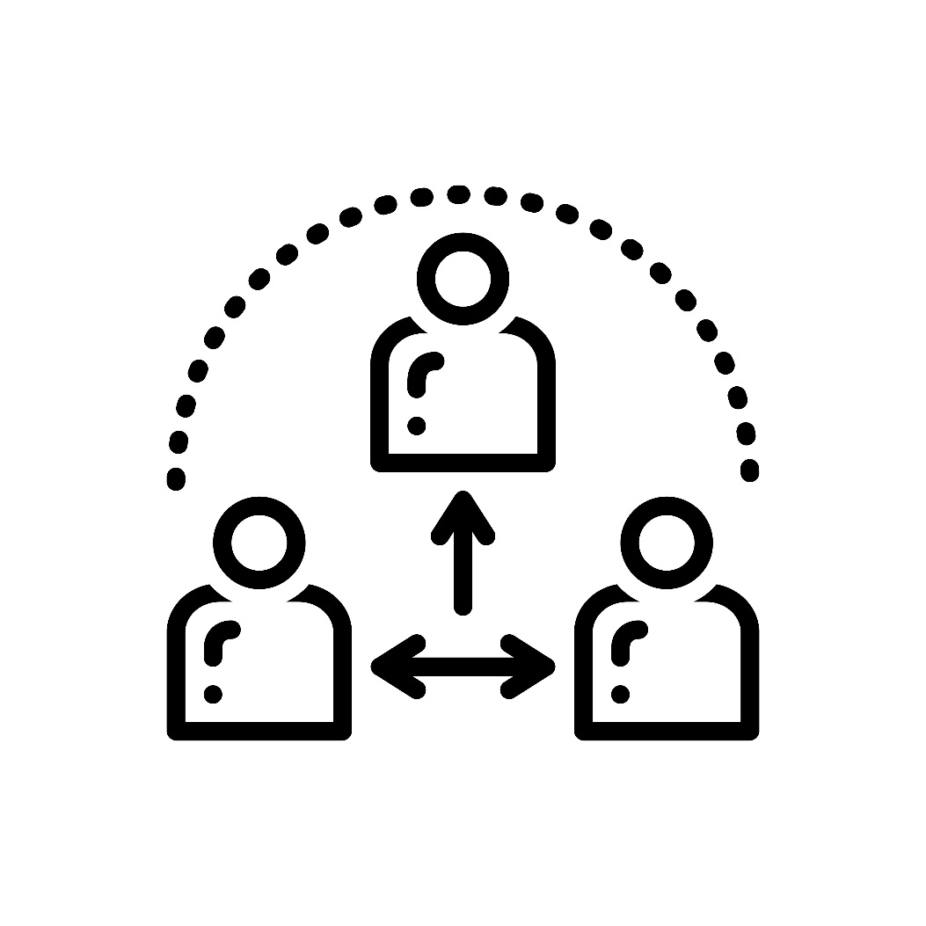
Confined Field Trials
When working with third parties (e.g., service contractors, research contractors, technology transfer licensees) it is important that agreements include stewardship and quality management provisions to maintain plant product integrity.

Slide 8
Confined Field Trials
Analyze Product Integrity Concerns
Determine Critical Control Points
Establish and Implement:
Preventive Measures
Monitoring and Verification Procedures
Corrective Measures
Incident Escalation and Response Procedures
Record Keeping and Documentation Procedures

Slide 9
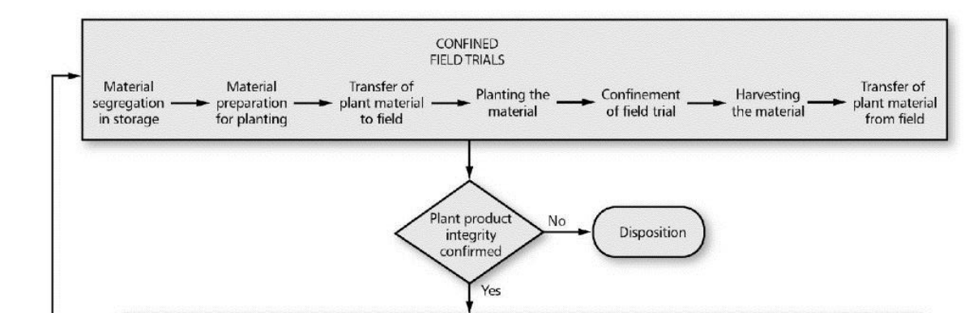
Confined Field Trials
Analyze Product Integrity Concerns
Misidentification and errors in evaluating the transgenic purity of plant material to be planted
Misidentification and errors in evaluating the transgenic purity of plant material to be harvested and retained
Insufficient isolation or control of plants to limit out-crossing
Inadvertent physical mixing or comingling of seed lots in storage or while being transported, cleaned, or processed
Errors in disposition

Slide 10
Confined Field Trials
Determine Critical Control Points
Segregation of unauthorized plant material in the country of cultivation
Preparation of plant material for planting
Transfer of plant material to the field trial site for planting (includes transfer to intermediate facilities such as field stations prior to planting)
Planting the materials
Harvesting the seed, grain or plant product
Processing seed, grain, or plant product
Transfer of plant material from the field trial site
Confirmation of confinement
Isolation to prevent inadvertent cross-contamination during pollen flow
Storage (if applicable) of harvested material
Use of harvested material in country of cultivation
Material disposition
Notes:
*Unauthorized refers to biotechnology-derived plant material that has not been authorized by the relevant competent authority for release into the environment for purpose of cultivation or for use in the food and feed chains.

Slide 11
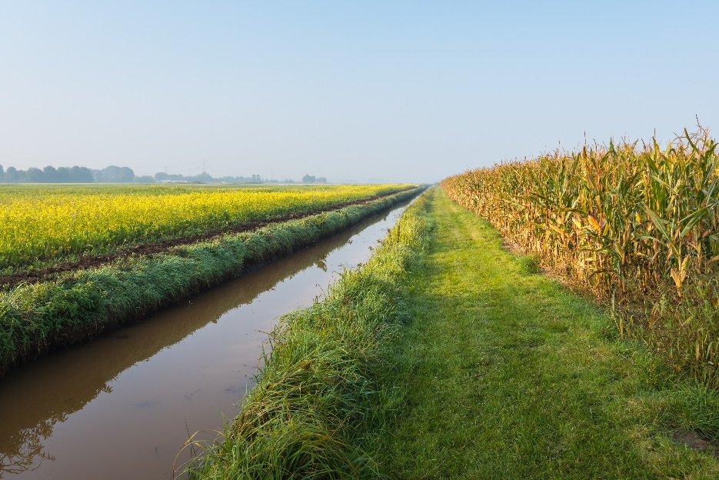
Confined Field Trials
Establish and Implement:
Preventive Measures
A procedure for site selection and planning for the controlled environmental release
Labeling, tracking, and disposition of plant material as part of an inventory system
Procedures to ensure that labels used to identify plants or seeds are recorded and information pertinent to identity is retrievable
Internal work processes and SOPs for traceability
Transfer protocols or processes for traceability across functions, departments, organizations, or locations
Protocols and/or SOPs for planting (e.g., procedures to ensure any equipment used for planting is free from contaminant seed/material prior to and following use; the plot design is clear and easy to follow to prevent errors, such as the wrong genotype planted in the wrong location of plot)
Protocols and/or SOPs for harvesting of the plant material to prevent cross contamination from other genotypes from both within the plot, or from other sources outside the plot (e.g., procedures to ensure any equipment or container (e.g., bag, bin, and envelope) used for harvest is free from contaminant seed/material prior to use)
Methods and controls for confinement (e.g., those for reproductive isolation around the field trial site and within the field trial site if required for transgenic purity, those for movement of personnel and equipment between trials of different events during pollen flow, those for cleaning of equipment prior to its leaving the trial site, those for disposition of plant material during season or after harvest, and those for post-harvest land-use restrictions)
Training for individuals involved with activities related to confined field trials
Notes:
*For the purposes of this module, labeling means to affix with a label (e.g., on a seed envelope) that is marked with a name and/or other information that can be used to facilitate confirmation of plant product identity

Slide 12
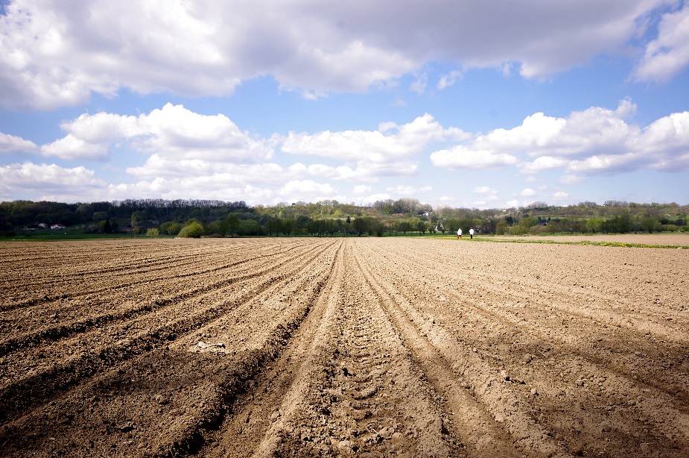
Confined Field Trials
Establish and Implement:
Monitoring & Verification Procedures
Confirm
Plant identity prior to transfer to the field trial site
Plant identity and assessment of transgenic purity of plant material from the trial site by documentation or by using diagnostic methods where appropriate
Confinement measures through assessment
Monitor the field-trial site at regular intervals to confirm that management practices to confine the field-trial site are implemented in accordance with regulatory and internal operational requirements
Volunteer monitoring
Notes:
*For the purpose of this Guide and unless otherwise indicated, confirmation of identity may be achieved using either procedural confirmation (e.g., documentation) or analytical confirmation (e.g., laboratory assays) or both. This will be determined based on individual circumstances and may warrant a case-bycase assessment

Slide 13
Confined Field Trials
Establish and Implement:
Corrective Measures
When a plant is misidentified, a plant is correctly identified but is not the desired genotype, or when identity cannot be confirmed, the plant material and any derivatives should be reviewed and appropriate disposition determined
Correct any deficiencies that could affect confinement of the field trial site and assess impact on plant product integrity
Incorporate any corrective measures or procedural changes into the SOP, as appropriate
If applicable, train personnel on the procedural changes incorporated
Incorporate reporting and resolution procedures for potential regulatory compliance incidents
Notes:
Verify the integrity of the construct as designed.
Confirm identity prior to transfer for plant transformation.
In the event that a construct is found to be incorrectly identified or where identity cannot be confirmed, review and determine the disposition of the construct and derivations.
Incorporate any corrective measures or procedural changes into work processes and SOPs as appropriate.
Documentation of identity and traceback should be secure, accessible, and retained as appropriate

Slide 14
Confined Field Trials
Establish and Implement:
Incident Escalation and Response Procedures
Establish and implement an incident response procedure (refer to Guide for Incident Response)
Documentation that personnel are trained to support robust systems to report and escalate any incidents of loss of control or containment of biotechnology derived plant material
Ensure corrective actions are taken and documented. If applicable, report incident to appropriate regulatory authorities
Notes:
Verify the integrity of the construct as designed.
Confirm identity prior to transfer for plant transformation.
In the event that a construct is found to be incorrectly identified or where identity cannot be confirmed, review and determine the disposition of the construct and derivations.
Incorporate any corrective measures or procedural changes into work processes and SOPs as appropriate.
Documentation of identity and traceback should be secure, accessible, and retained as appropriate

Slide 15
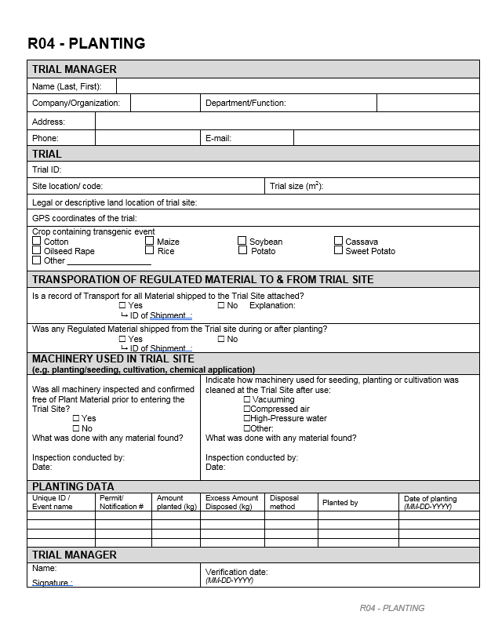
Confined Field Trials
Establish and Implement:
Record Keeping and Documentation Procedures
Documentation of trial conduct, identity and traceability should be secure, accessible, and retained as appropriate
Methods should be established and implemented to develop and record the trial protocol to provide trial execution guidance from planning through final disposition of harvested material
Procedures for the retention of documentation related to non-conformities and follow up actions
Processes to communicate changes in regulatory status and trial requirements (if applicable) to relevant parties. For example, the transition of confined field trials from regulated to stewarded status
Notes:
Verify the integrity of the construct as designed.
Confirm identity prior to transfer for plant transformation.
In the event that a construct is found to be incorrectly identified or where identity cannot be confirmed, review and determine the disposition of the construct and derivations.
Incorporate any corrective measures or procedural changes into work processes and SOPs as appropriate.
Documentation of identity and traceback should be secure, accessible, and retained as appropriate

Slide 16
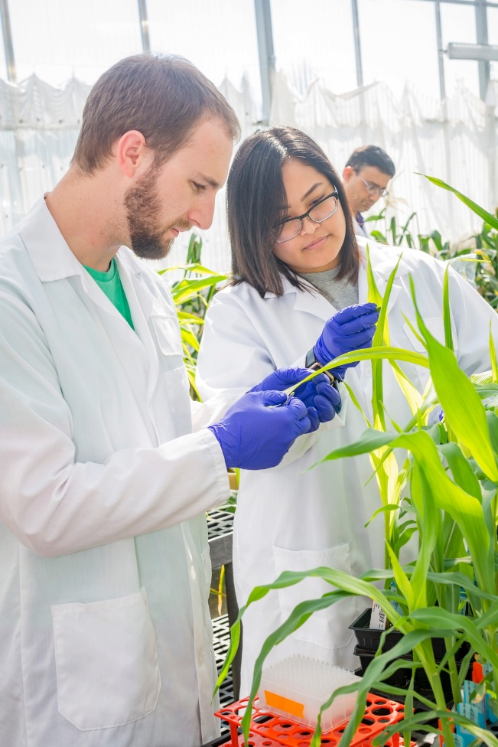
Confined Field Trials
Other Stewardship Considerations
Biology of the host plant/breeding protocol
Receiving environment
Implications of regulatory requirements
Operating procedures
Notes:
The construct used to transform the host plant is typically comprised of one or more genes of interest coupled with specific regulating elements (e.g., promoters, terminators, transit peptides, etc.).
It is usual practice to identify or confirm the identity of the coding and non-coding sequences that will be inserted into the host genome.

Slide 17
Confined Field Trials
Examples of what could go wrong?
Loss of information (the database is out of order, with no backup)
The final host plant reveals it doesn't contain the intended construct
Loss of confinement
(e.g. Comingling with non-regulated GM)
Accidental transfer of harvested commodity to commercial grain channel
Loss of traceability
(e.g. a label is missing)
Identity control has not been performed at a critical control point
Loss of containment

Slide 18
Confined Field Trials
Examples of what could go wrong?
USDA’s two most common permit condition noncompliance's:
Notes:
Then one could describe the types of losses of confinement:
Loss of seed in shipment
Loss of isolation measures
Border row stand loss
Saved seed activity planted closer than planned/expected
Equipment shared with saved seed activity resulting in commingling
Equipment not sufficiently cleaned
Then used for another activity
Comingling with non-regulated GM
Loss of seed during transport of equipment following planting/harvest
Pollen flow not mitigated sufficiently. Viable pollen from reg-GM or non-commercial GM activity reaches and successfully pollinates commercial crop or saved seed activity in compatible species.
Accidental harvest
Accidental transfer of harvested commodity to commercial grain channel

